Slide 1
Django

Slide 2
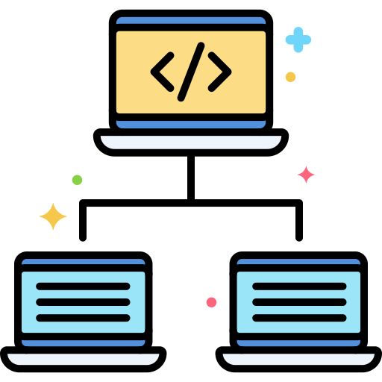
What is framework?????
Frameworks provide a set of tools and elements that help in the speedy development process. It acts like a template that can be used and even modified to meet the project requirements.
With the help of framework, you can avoid writing everything from scratch
Frameworks are based on programming languages.
Some popular frameworks are Django , Spring Boot, Angular

Slide 3

Django
Django is a high-level Python web framework that encourages rapid development and clean
Features of Python
Ridiculously fast.
Secure
Scalable

Slide 4
Install Virtual Environment
To create virtual environment
Command to create virtual environment:
virtualenv environment_name

Slide 5
How to activate a virtual Environment
Env_name\scripts\activate
How to deactivate a virtual Environment
Env_name\scripts\deactivate

Slide 6
Creating Project in Django
To run project

Slide 7
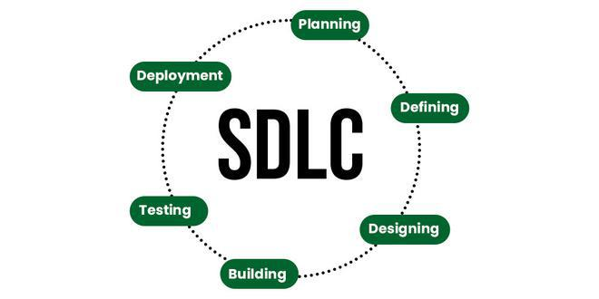
Software Development Life Cycle

Slide 8
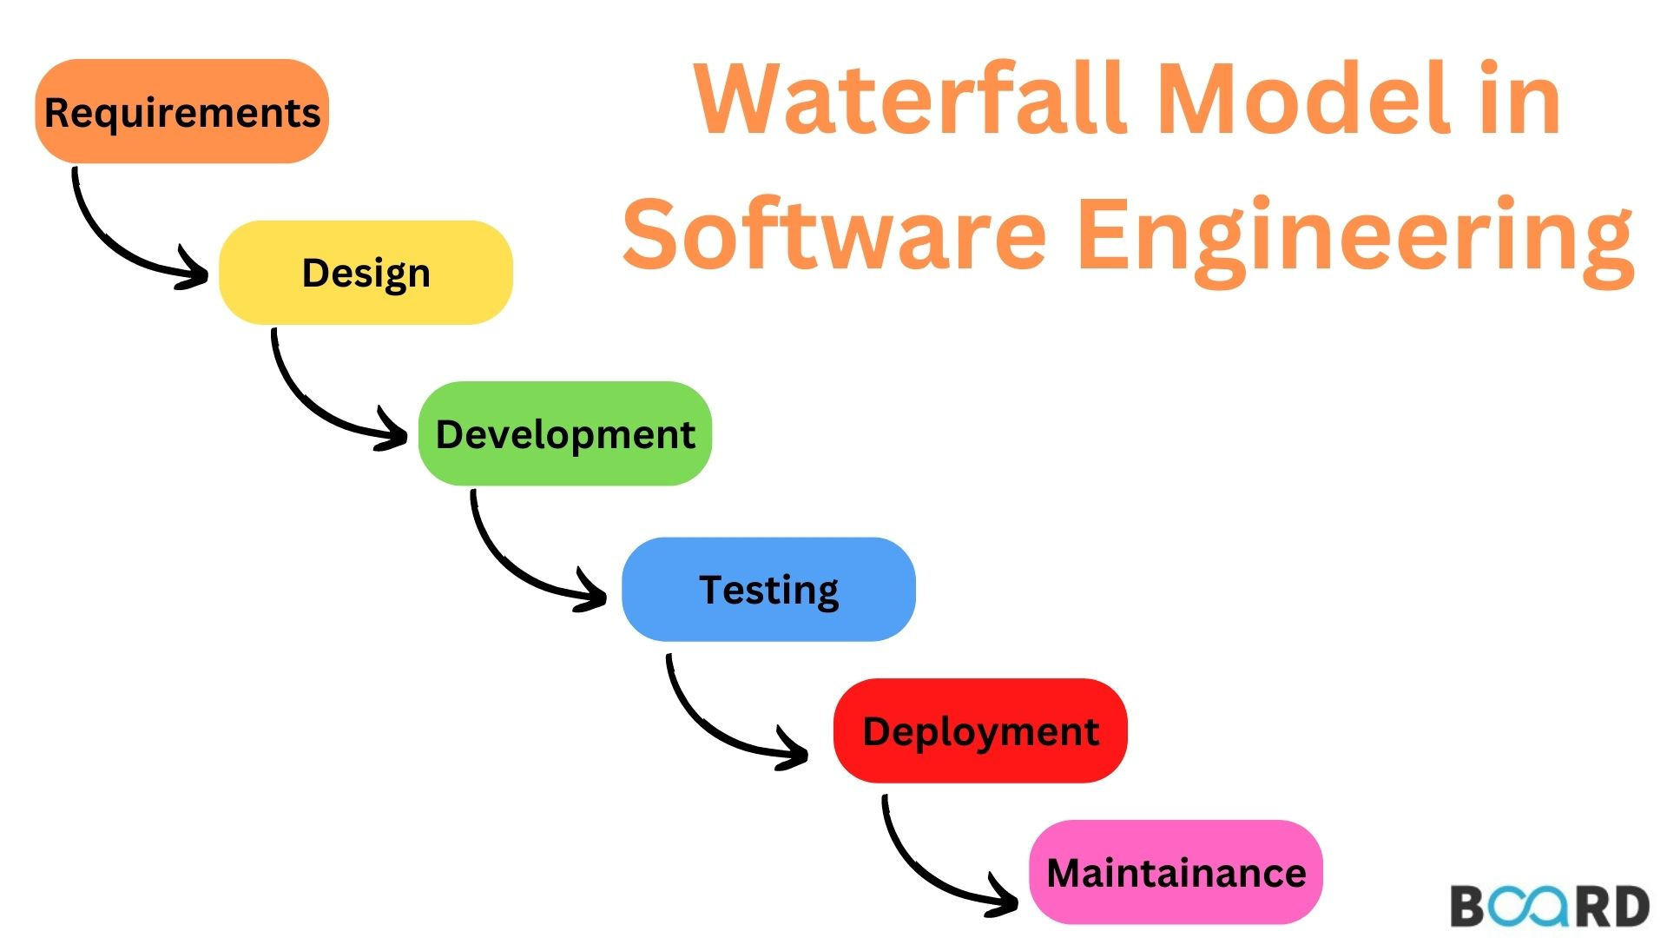
Waterfall Model

Slide 9
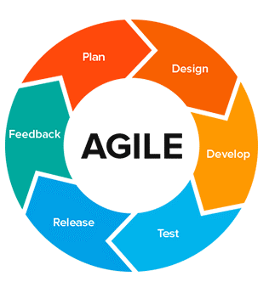
Agile Methodology

Slide 10
What is Scrum???
A better way for building products

Slide 11
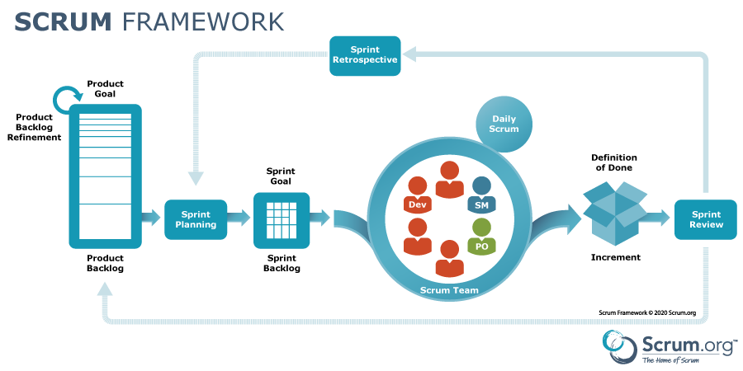

Slide 12
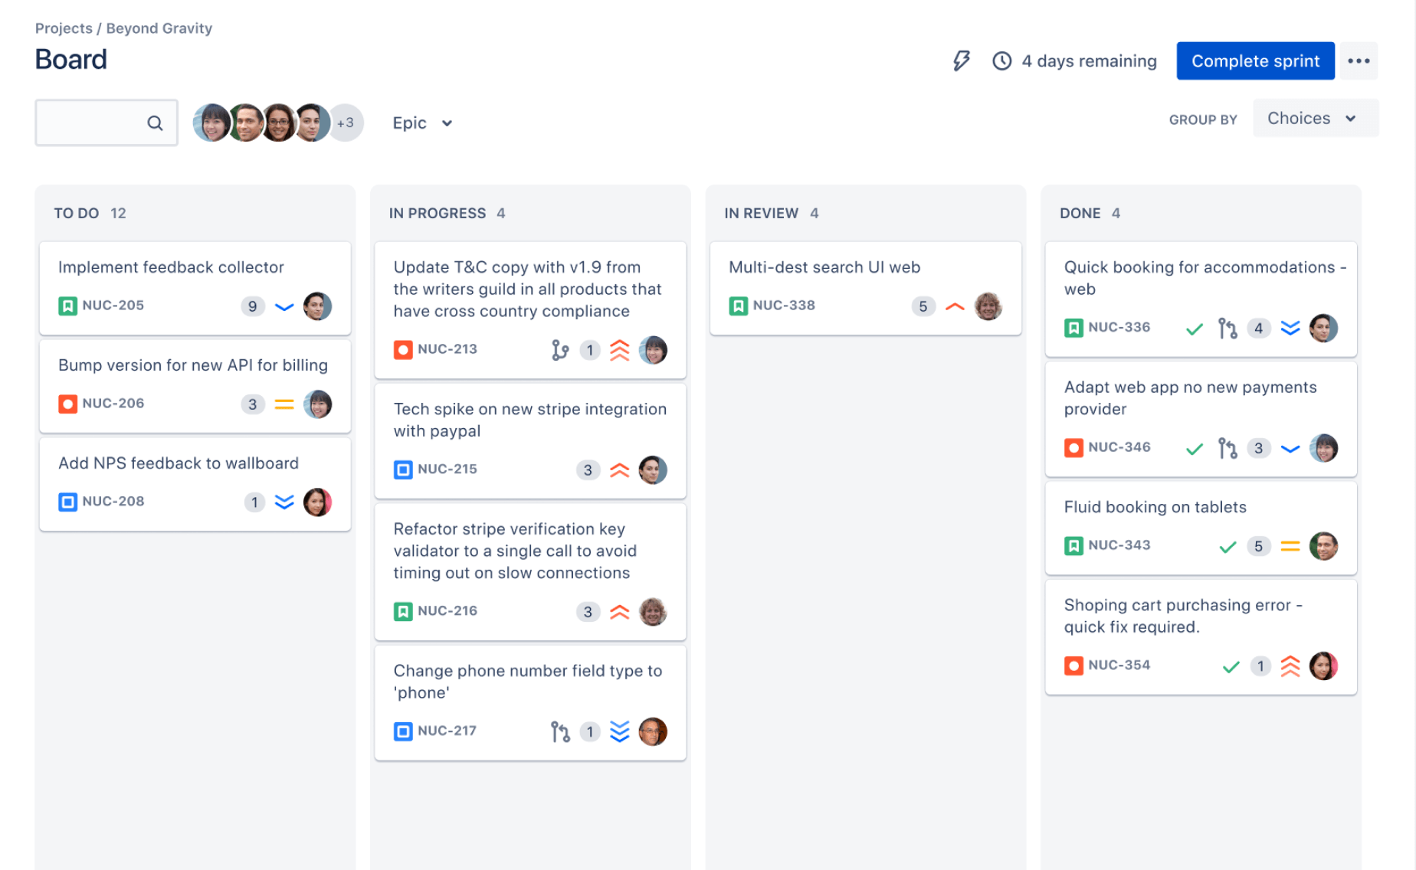

Slide 13
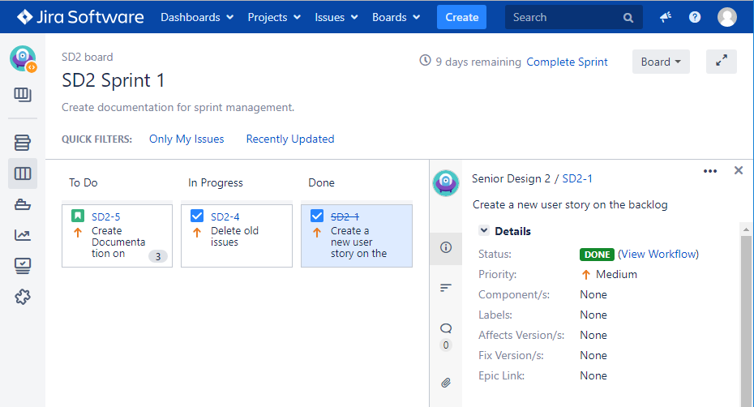

Slide 14
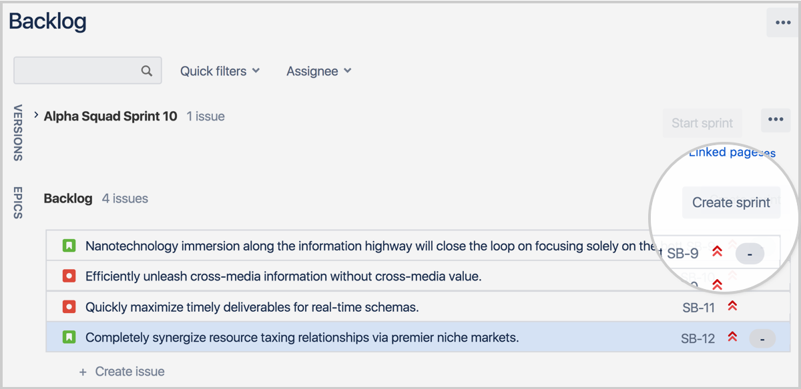

Slide 15
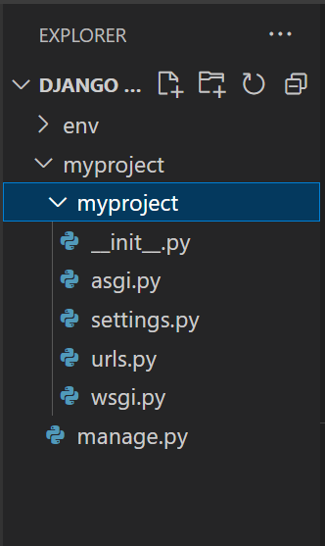
__init__.py
This empty file tells Python that this folder is a Python package.

Slide 16
settings.py
A Django settings file contains all the configurations of your Django Project.
Example:Installed_apps,Database configurations

Slide 17
manage.py
It is used to run management commands related to our project. We will use it to run the development server, run tests

Slide 18
wsgi.py
WSGI is the Web Server Gateway Interface. It is a specification that describes how a web server communicates with web applications,

Slide 19
asgi.py
ASGI is the asynchronous Server Gateway Interface. It is a replacement for wsgi.py

Slide 20
In Django, a project is typically composed of one or more applications.
SocialMedia Project
Profiles
Posts
Notifications

Slide 21
Creating app in Django
Don’t forget to add app name in settings.py [installed_apps]

Slide 22
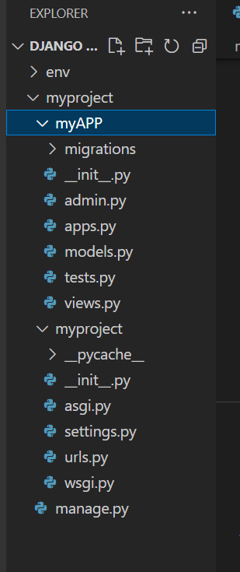
admin.py
The admin.py file is where you define settings, configurations, and customizations specific to the Django Admin for your app.
app.py
The app.py has configuration related to your app
Views.py
Django views are Python functions that takes http requests and returns http ... Views are usually put in a file called views.py located on your app's folder.

Slide 23
Tests.py
It is used to run and write tests for your application
models.py
In Django, data is created in objects, called Models, and is actually tables in a database. To create a model, navigate to the models.py

Slide 24
MVT (Model View Template)
Model | The Model represents the data. It defines the structure of the database, including how data is stored, retrieved, and manipulated. In Django, models are often used to interact with the database, representing tables and relationships between them.
View | The View is responsible for processing user requests and returning appropriate responses. It interacts with the Model to retrieve data and then passes that data to the Template for presentation.
Template | The Template is responsible for the presentation layer. It defines how the data from the View is displayed.

Slide 25
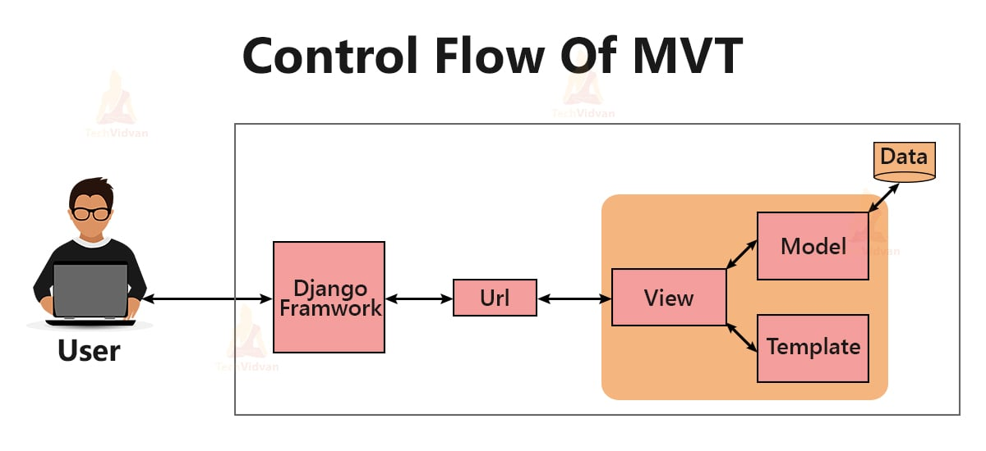

Slide 26
Views
Function Based View
Class Based View

Slide 27
Function Based Views
Function based views are written using a function in python which receives as an argument HttpRequest object and returns an HttpResponse Object.
A view function, or view for short, is a Python function that takes a web request and returns a web response.

Slide 28
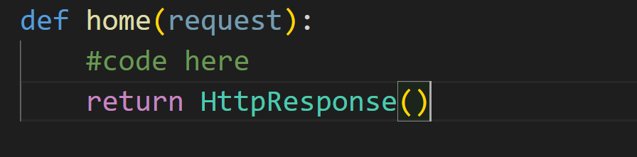

Slide 29
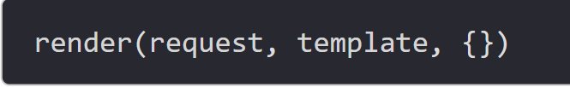
render()
Render function combines template with a context dictionary and returns an HttpResponse object with the rendered text.
Syntax:

Slide 30
Arguments
It takes the following three arguments.
request: This is the request
template: This is the template file that will be rendered.
context dictionary: This is a dictionary where we store data that can be used by the template.

Slide 31
HttpRequest.method
A string representing the HTTP method used in the request. This is guaranteed to be uppercase. For example:
HttpRequest.method | ‘GET’
HttpRequest.method | ‘POST’
HttpRequest.method | ‘PUT’
HttpRequest.method | ‘DELETE’

Slide 32
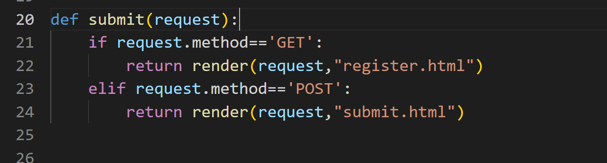

Slide 33
Class Based Views
Using Class-Based views, we can easily handle the GET, POST requests for a view.
Class-based views provide an alternative way to implement views as Python objects instead of functions
Class based Views: https://docs.djangoproject.com/en/5.0/ref/class-based-views/flattened-index/#view
Django:: https://docs.djangoproject.com/en/5.0/ref/class-based-views/base/#django.views.generic.base.View.as_view

Slide 34
Base View
View
TemplateView
RedirectView
Generic date View
DateDetailView
ArchiveIndexView
YearArchiveView
MonthArchiveView
WeekArchiveView
DayArchiveView
TodayArchiveView
Generic Display view
DetailView
ListView
Generic editing view
UpdateView
DeleteView
FormView
createView

Slide 35
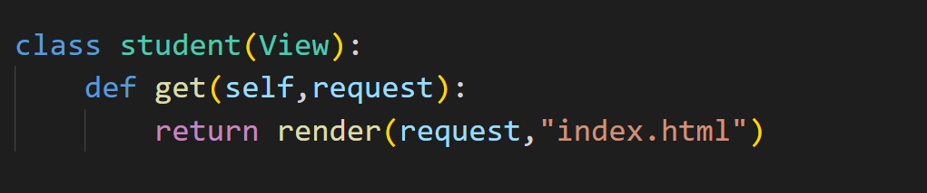
View
Import View class from view module

Slide 36
As_view():::Returns a callable view that takes a request and returns a response:
When the view is called during the request/response cycle, the setup() method assigns the HttpRequest to the view’s request attribute, and any positional and/or keyword arguments captured from the URL pattern to the args and kwargs attributes, respectively. Then dispatch() is called.

